Slide 1
DIGESTIVE
SYSTEM
Dr. Hanaa Salman Kadhum
Pathological Analysis Department
Collage of Science

Slide 2
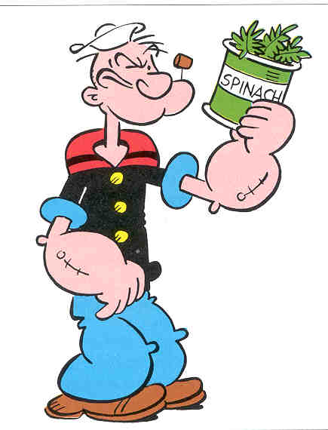
The primary function of the alimentary tract is to break down food and to provide the body with a continual supply of water, electrolytes and nutrients. To achieve this function, the GIT must performs the following processes: ingestion, movement, digestion, absorption, secretion and defecation.
GIT is a tube running through the body from mouth to anus.

Slide 3
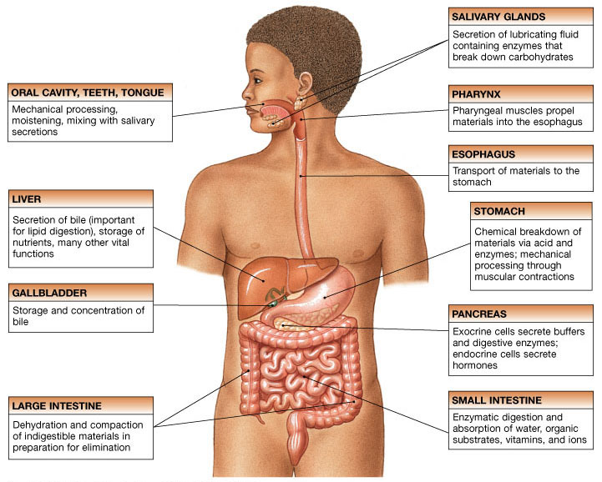
Figure 24.1

Slide 4
Phases of digestion Include :
1. Ingestion
2. Movement
3. Mechanical and Chemical Digestion
4. Absorption
5. Elimination
Types
▪ Mechanical (physical)
▪ Chew
▪ Tear
▪ Grind
▪ Mash
▪ Mix
▪
Chemical
▪ Enzymatic reactions to improve digestion of
▪ Carbohydrates
▪ Proteins
▪ Lipids

Slide 5
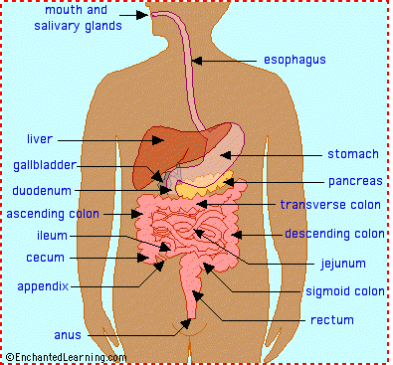
The digestive system is a continuous tube that begins at the mouth and ends at the anus. Measuring about 30 feet long in the average adult, it is known as the alimentary canal or gastrointestinal tract. It has 3 functions: the digestion of food into nutrients, the absorption of nutrients into the bloodstream, and the elimination of solid wastes.
What is the digestive system?

Slide 6
Processes of the Mouth
Mastication (chewing) of food (mechanical digestion)
Mixing masticated food with saliva (chemical digestion)
Initiation of swallowing by the tongue
Allowing for the sense of taste

Slide 7
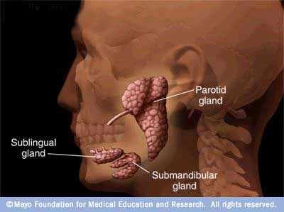
The mouth: salivary glands…
Three pairs of glands open into the oral cavity, producing saliva: the parotid sublingual and submandibular glands.
The sensory organs such as the nose and eyes send a message to the brain, the brain sends the message to the salivary glands, and they secrete the chemicals to begin the digestive process.

Slide 8
Lubrication of food by saliva
Salivary glands
In addition to the chewing, another important physiological activity
which takes place in the mouth is lubrication of food by saliva. Saliva is
secreted by three pairs of major salivary glands:
1. Parotid glands: Parotid glands are the largest salivary glands (each weighing 20–30 g), located near the angles of jaw. Parotid glands secrete
25% of the total salivary secretion (which is about 1500 ml/day).

Slide 9
2. Sublingual glands: The sublingual gland is the smallest of the three main salivary glands. It lies just below the mucosa on the floor of mouth. Each gland raises a ridge of mucosa which starts at the sublingual papilla and runs laterally
and backwards. The ridge is called the sublingual fold.
3. Submandibular glands: The submandibular glands are large salivary glands which lie (one on each side) partly under cover of the body of the mandible. Each gland is made up of a large superficial part and a small deep part.
Smaller salivary glands: In addition to the three pairs of salivary glands described above, several smaller glands are located throughout the oral cavity. Those in the tongue secrete lingual lipase.
Saliva
The composition of salivary secretion depends on its source and rate of
secretion. Serous secretion is watery and mainly contains electrolytes and
amylase, whereas mucous secretion is viscous in nature, and it contains
electrolytes and mucin.

Slide 10
Amount: Under normal circumstances, the salivary glands secrete about 500–1500 ml of saliva every day. pH of saliva varies from 6 to 7.4.
Composition: Saliva is composed of:
Water: 99%, and
Solids: 1%, which include:
- Organic substances such as L-amylase (ptyalin), lingual
lipase, kallikrein, lysozyme, small amounts of urea, uric acid, cholesterol and mucin.
Inorganic substances are Na+, Cl−, K+ and HCO−3.
Phases of salivary secretion
1. Cephalic phase refers to secretion of saliva before entering of food into
the mouth. It is caused by a conditioned reflex initiated by the mere sight
or smell of food.
2. Buccal phase refers to secretion of saliva caused by stimulation of buccal
receptors by the presence of food in the mouth. It is an unconditioned
reflex, partially regulated by the appetite area of the brain.
3. Oesophageal phase occurs due to stimulation of salivary glands to a
slight degree by the food passing through oesophagus.

Slide 11
4. Gastric phase refers to secretion of saliva by the presence of food in the
stomach. It specially occurs when irritant food is present in the stomach
(e.g. increased salivation before vomiting).
5. Intestinal phase refers to salivary secretion caused by presence of
irritant food in the upper intestine.
Functions of saliva
1. Protective function
• Dilutes hot and irritant food substances thus preventing injury to the
buccal mucosa.
• Washes away food particles that remain in the oral cavity at the end of
meal and thus cleans the oral cavity.
• Destroys harmful bacteria in the mouth and thus minimizes risk of buccal
infection and dental caries.
2. Role in mastication and deglutition
3. Digestive functions
4. Role in taste sensation
5. Role in speech

Slide 12
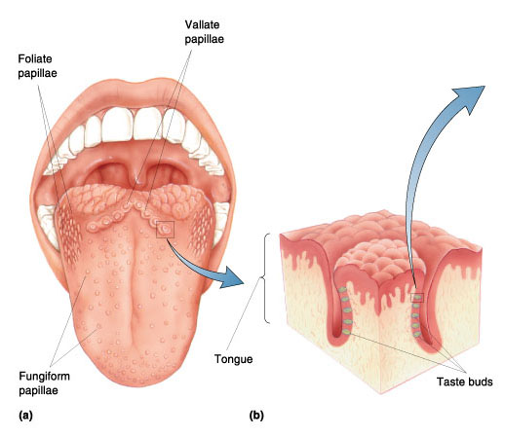
The mouth: tongue
The tongue is a muscle covered with a mucous membrane. It has a rear portion called the root, the tip, and the central body. It is covered with taste buds and raised elevations called papillae.
The taste buds taste sweet, sour, salt, bitter.

Slide 13
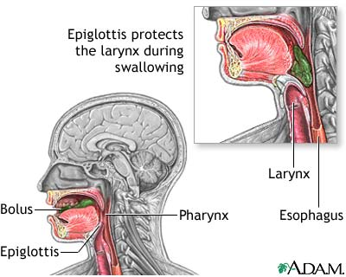
The mouth: teeth
The teeth are used for chewing the food…mastication. The food is broken apart and mixed with saliva to form a bolus, ready to be swallowed.
Muscular constrictions move the bolus through the pharynx (soft palate at the back of the mouth) and into the esophagus while blocking the opening to the larynx and preventing the food from entering the airway.

Slide 14
Pharynx Function
Serves as a passageway for air and food
Food is propelled to the esophagus by two muscle layers
Food movement is by alternating contractions of the muscle layers (peristalsis)

Slide 15
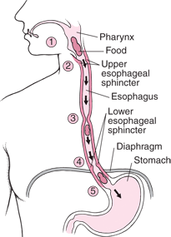
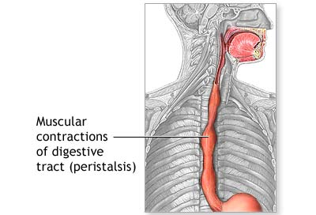
The esophagus…
The food is moved down the esophagus toward the stomach by wavelike muscular contractions called peristalsis. At the opening of the stomach is the lower esophageal sphincter. This is a muscle valve that permits the passage of food, but not the backup of stomach contents under normal conditions.

Slide 16
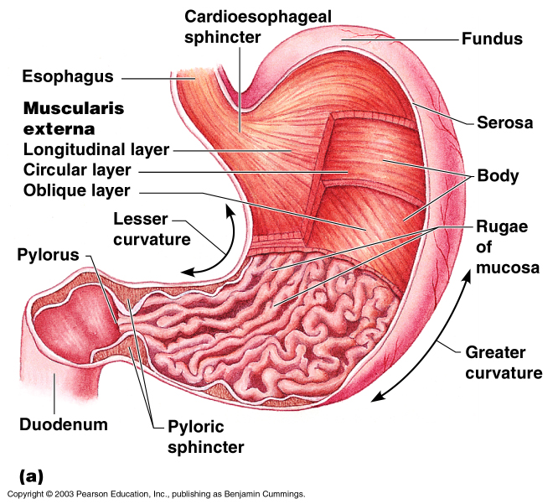
Stomach Anatomy
Figure 14.4a

Slide 17
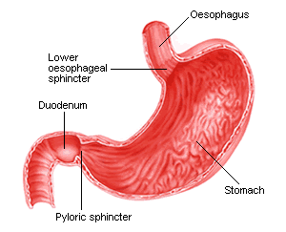
The stomach…
The stomach is a muscular, expandable organ, the upper portion called the fundus and the lower portion called the antrum. Hydrochloric acid and other gastric juices convert the food to a semiliquid state called chyme.
Chyme passes through the pyloric sphincter valve at the bottom of the stomach, into the small intestine.

Slide 18
Parts of stomach
The stomach can be divided into five anatomic regions:
• Cardiai s the narrow conical portion of the stomach immediately distal
to the gastroesophageal junction.
• Fundus is the dome-shaped proximal portion of the stomach.
• Body or corpusis the main part of the stomach that extends up to the
incisura angularis.
• Pyloric antrum extends from the incisura angularis to the pyloric canal.
• Pyloric canal or pylorusis the distal-most 1-inch-long tubular part of
stomach.
Cells of Stomach:
• Chief cells, also known as peptic or zymogen cells are basophilic. These cells are concentrated at the base of the main gastric glands. These cells secrete proteolytic proenzymes and pepsinogen I and II.

Slide 19
• Parietal cells, also known as oxyntic cells are acidophilic. These cells predominantly line the upper half of the glands and have an extensive intracellular canalicular system. These secrete hydrochloric acid(HCl) and the
intrinsic factor.
• Mucus cells, which secrete soluble mucusand
• G-cells, which are responsible for release of the hormone
gastrin.
Physiology of gastric secretion
The gastric secretions include:
• Exocrine secretions ,i.e. gastric juice
• Endocrine secretions, i.e. gastrin hormone.

Slide 20
Gastric juice
Gastric glands secrete about 2–2.5 L of gastric juice in the lumen of
stomach per day. It is acidic with a pH varying from 1 to 2. Important constituents of gastric juice are:
• Water 99.45%
• Solids 0.55%, which include:
• Electrolytes such as Na+ , K+ , Mg2+ , Cl− , HCO3 , HPO4,and SO4.
The electrolyte content of gastric juice varies with the rate of secretions.
At low secretory rates, Na+ concentration is high and H+ concentration
is low, but as acid secretion increases Na+ concentration falls.
• Enzymes present in the gastric juice are:
• Pepsinis a proteolytic enzyme which is secreted by chief cells of gastric glands in an inactive form pepsinogen.
Pepsinogen is activated to pepsin in the presence of HCl at an optimal pH of about 2.

Slide 22
• Gastric lipaseis a weak fat-splitting enzyme. It is of little importance in fat digestion except in pancreatic insufficiency.
• Gastric gelatinase liquefies gelatin, a protein contained in connective tissue.
• Gastric amylase is present in small amounts.
• Lysozyme is bactericidal.
• Carbonic anhydrase is present in small amounts.
• Mucin or mucus is of two types:
• Soluble mucus secreted by mucus cells of pyloric and cardiac glands
• Insoluble mucus secreted by surface foveolar cells (tall columnar mucin secreting cells) lining the entire gastric mucosa.
• Intrinsic factor is secreted by parietal cells of gastric glands.

Slide 23
Stomach Functions
Acts as a storage tank for food
Site of food breakdown
Chemical breakdown of protein begins
Delivers chyme (processed food) to the small intestine
Produces 2-3L/day of gastric juice (HCl, enzymes, & mucus)
Regulated by neural & hormonal factors

Slide 24
1. GASTRITIS
Inflammation of gastric mucosa is called gastritis. It may
be acute or chronic. Acute gastritis is characterized by
inflammation of superficial layers of mucus membrane
and infiltration with leukocytes, mostly neutrophils.
Chronic gastritis involves inflammation of even the
deeper layers and infiltration with more lymphocytes. It
results in the atrophy of the gastric mucosa, with loss
of chief cells and parietal cells of glands. Therefore, the
secretion of gastric juice decreases.
Causes of Acute Gastritis
i. Infection with bacterium Helicobacter pylori
ii. Excess consumption of alcohol
iii. Excess administration of Aspirin and other nonsteroidal
antiinflammatory drugs (NSAIDs)
iv. Trauma by nasogastric tubes
v. Repeated exposure to radiation (rare).
Causes of Chronic Gastritis
Chronic infection with Helicobacter pylori
ii. Longterm
intake of excess alcohol
iii. Longterm
use of NSAIDs
iv. Autoimmune disease.

Slide 25
Features of gastritis are nonspecific. Common feature
is abdominal upset or pain felt as a diffused burning
sensation. It is often referred to epigastric pain. Other
features are:
i. Nausea
ii. Vomiting
iii. Anorexia (loss of appetite)
iv. Indigestion
v. Discomfort or feeling of fullness in the
epigastric region
vi. Belching (process to relieve swallowed air
that is accumulated in stomach).
PEPTIC ULCER
Ulcer means the erosion of the surface of any organ due
to shedding or sloughing of inflamed necrotic tissue that
lines the organ. Peptic ulcer means an ulcer in the wall
of stomach or duodenum, caused by digestive action
of gastric juice. If peptic ulcer is found in stomach, it
is called gastric ulcer and if found in duodenum, it is
called duodenal ulcer.

Slide 26
Causes
i. Increased peptic activity due to excessive
secretion of pepsin in gastric juice
ii. Hyperacidity of gastric juice
iii. Reduced alkalinity of duodenal content
iv. Decreased mucin content in gastric juice or
decreased protective activity in stomach or
duodenum
v. Constant physical or emotional stress
vi. Food with excess spices or smoking (classical
causes of ulcers)
vii. Longterm
use of NSAIDs (see above) such as
Aspirin, Ibuprofen and Naproxen
viii. Chronic inflammation due to Helicobacter pylori.
Features
Most common feature of peptic ulcer is severe burning
pain in epigastric region. In gastric ulcer, pain occurs
while eating or drinking. In duodenal ulcer, pain is felt 1
or 2 hours after food intake and during night.
Other symptoms accompanying pain are:
i. Nausea
ii. Vomiting
iii. Hematemesis (vomiting blood)
iv. Heartburn (burning pain in chest due to regurgitation
of acid from stomach into esophagus)
v. Anorexia (loss of appetite)
vi. Loss of weight.

Slide 27
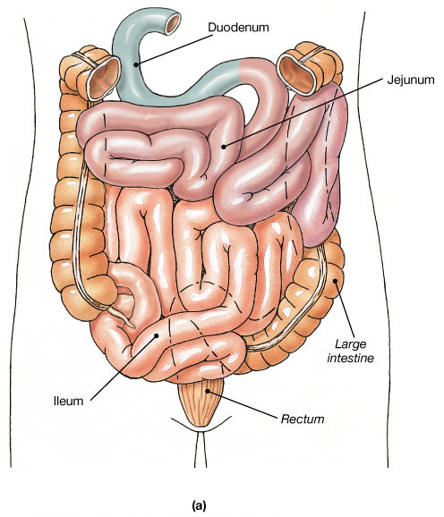
Regions of the Small Intestine

Slide 28
Small intestine :
The small intestine is a convoluted tube that extends from the pylorus to
the ileo-caecal valve, where it joins with caecum, the first part of large
intestine. It is about 6–7 m in length, and its diameter gradually
diminishes from its commencement to its termination. It is divided into
three parts: the duodenum, the jejunum and the ileum.
Duodenum.
The first and shortest part (25 cm long) of the small intestine is also the
widest and most fixed part. It is C shaped, and for descriptive purposes is
divided into four parts: superior (1st) part, descending (2nd) part,
horizontal (3rd) part and ascending (4th part). Superior part of
duodenum is also called duodenal cap or bulb. It is the region which is
struck by acidic gastric contents when they pass through pylorus and is a
common site for the peptic ulcer. The bile and pancreatic ducts open by a
common hepatopancreatic ampulla of Vater on the posteromedial wall of

Slide 29
descending (2nd) part of duodenum. Ligament of Treitz demarcates the
continuation of duodenum with jejunum.
Jejunum and ileum.
Jejunum and ileum form respectively, the proximal 2/5th and distal 3/5th
of the remaining part of small intestine. There is no sharp demarcation
between jejunum and ileum. The inner mucosal surfaces of jejunum and
ileum, however, can be differentiated from each other.
Small intestinal secretions
The intestinal juice, also called succus entericus, comprises the intestinal
secretions which include:
• Aqueous component (water and electrolytes),
• Intestinal enzymes and
• Mucus.

Slide 30
Chemical Digestion in the Small Intestine
Source of enzymes that are mixed with chyme
  Intestinal cells
  Pancreas
Bile enters from the gall bladder

Slide 31
Intestinal enzymes
1. Peptidases
(proteolytic enzymes) which digest peptides into amino acid, e.g.
aminopeptidases, dipeptidases, nuclease, related enzymes and so on.
2. Disaccharidases
such as sucrase, maltase and lactase which split the respective
disaccharidases into the monosaccharides.
3. Intestinal lipases
that split triglycerides present in small amount.
4. Enterokinase
or enteropeptidase which activates trypsinogen to trypsin.

Slide 32
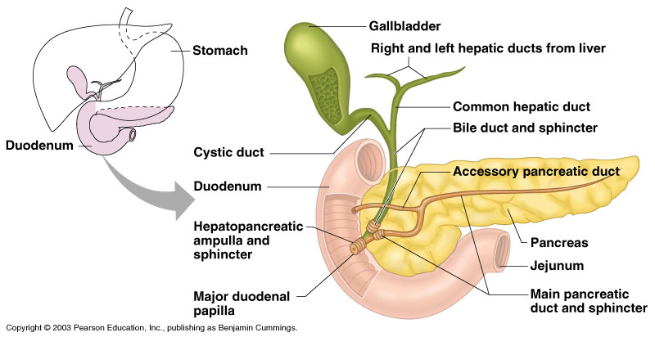
Chemical Digestion in the Small Intestine
Figure 14.6

Slide 33
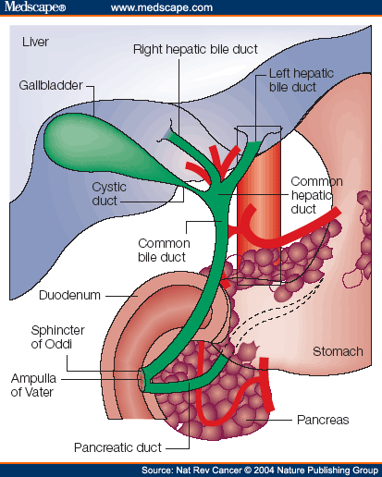
The small intestine: the liver
The liver’s primary contribution to digestion is the production of bile or gall which drains into the duodenum, and some is stored in the gallbladder. It travels through the hepatic ducts, which merge together. Bile helps digest fats. The liver also stores iron and the fat-soluble vitamins A, D, E, and K.

Slide 34
• In current terminology, the liver consists of right and left functionally
independent parts called the portal lobes, that are approximately equal
in size. Thus, functionally the left part of the liver includes the caudate
lobe and most of the quadrate lobe.
• The right and left functional parts of the liver have their own blood
supply from the hepatic artery and portal vein and their own venous
and biliary drainage.
• The liver has got considerable physiological reserve. Even after
removal of 80% of liver tissues, all physiological functions of the liver
can be accomplished normally. Furthermore, even if 90% of bile ducts
are ligated, the volume of bile secreted remains normal.
• The liver possesses considerable regeneration power. Original liver mass
is restored within 6–8 weeks of removal of up to 3/4ths of liver. This
occurs due to active mitotic division of the cells.

Slide 35
Functions of liver
I. Secretory functions
Liver cells act as exocrine glands and continuously secrete bile which is
important for digestion and absorption of fats. Various aspects of the bile
juice are discussed in this chapter.
II. Metabolic functions
Liver is the key organ and the principal site where the metabolism of
carbohydrates, lipids and proteins takes place. Liver is also involved in
the metabolism of vitamins and minerals to a certain extent.
III. Detoxicating and protective functions
• Kupffer cells efficiently remove bacteria and other foreign bodies from
portal circulation. This is the blood cleansing action of the liver.
• The biochemical detoxifying action of liver is brought about by a large
number of cytochrome P450 enzymes from hepatocytes. These enzymes
convert xenobiotics and other toxins into their inactive form.

Slide 36
IV. Storage functions
Liver stores glucose (in the form of glycogen), vitamin B12 and vitamin A.
• Liver acts as a blood iron buffer and iron storage medium. It stores 60%
of excess of iron mainly in the form of ferritin and partly as haemosiderin.
V. Excretory functions
Ammonium excretion: The liver is the only site where circulating ammonia is converted into urea and then excreted by the kidney into the urine.
• Cholesterol, alkaline phosphate and bilirubin are excreted in the bile.
• A number of drugs, adrenocortical and other steroid hormones are
excreted in the bile.
• Ammonia is critically handled by the liver, as it is freely permeable
across the blood–brain barrier; therefore, it is toxic to CNS tissue.
VI. Synthesis function
• Plasma proteins, especially albumin and to some extent α- and β-
globulins.

Slide 37
• Some blood coagulation factors. Liver cells are responsible for
conversion of preprothrombin (inactive) to active prothrombin in the
presence of vitamin K. It also produces other clotting factors such as
fibrinogen factor (I), factors V, VII, IX and X.
• Enzymes, such as alkaline phosphatase, serum glutamic oxaloacetic
transaminase (SGOT), serum glutamic pyruvic transaminase (SGPT)
and serum isocitrate dehydrogenase (SICD).
• Urea. Liver removes ammonia from the body to synthesize urea.
• Cholesterol. It is synthesized from the active acetate.
Bile and gallbladder
• Bile is a digestive juice, formed continuously in the liver by the hepatic
cells (hepatocytes), and by epithelial cells lining the bile ducts (ductal
cells).
• It is poured into the bile canaliculi from where it ultimately goes to the
common hepatic duct which join with cystic duct to form the common
bile duct. During interdigestive period when the sphincter of Oddi is
closed, the bile is directed via the cystic duct to the gallbladder, where
it is stored and concentrated.

Slide 38
• During meals, the sphincter of Oddi is relaxed, and when food reaches
the duodenum, there occurs release of CCK which causes contraction
of the gallbladder. Then the bile is released into the duodenum along
with the pancreatic juice through the common opening ampulla of
Vater.
Formation and composition of bile
The bile is formed by the hepatocytes and ductal cells lining the hepatic
ducts. The hepatocytes, one surface of which is adjacent to the blood
sinusoids and other to the biliary canaliculi, pick up some constituents of
bile from the blood (e.g. bile pigments), synthesize some constituents (e.g.
bile salts) and secrete a mixture into the biliary canaliculi. Ductular cells
contribute HCO3− and Cl− to the mixture giving rise to hepatic bile .

Slide 39
Functions of gallbladder
Gallbladder is a thin walled sac-like structure with a storage capacity of
about 50 ml. It is not essential for life. Removal of gallbladder
(cholecystectomy) in patients suffering from dysfunction of gallbladder
does not result in any major disadvantages. Functions of gallbladder are:
1. Storage of bile.
2. Concentration of bile.
3. Effect on the pH of bile.
4. Secretion of mucus.
5. Regulates equalization of pressure in biliary system.
Functions of bile
Functions subserved by the bile poured into the duodenum are because
of its constituents (mainly bile salts), which have already been discussed.
However, they are compiled and summarized once again:

Slide 40
1. Digestive function.
2. Absorptive functions.
3. Excretory function.
4. Laxative action.
5. Protective action.
6. Choleretic action
7. Maintenance of pH of GIT.
8. Prevention of gall stone formation.
9. Lubricating function.
10. Cholagogue function

Slide 41
Liver function tests
The liver function tests (LFTs) are the investigations to assess the
capacity of the liver to carry out any of the functions it performs. Thus,
LFTs help in:
• Assessing the extent of functional damage to the liver,
• Diagnosing the cause of hepatic insufficiency and
• Assessing the progress/regress of the disease.
The major LFTs may be classified as:
I. Tests to assess secretory functions,
II. Tests to assess metabolic functions,
III. Tests to assess synthesis functions,
IV. Tests to assess detoxicating functions,
V. Tests to assess hepatic cellular integrity and
VI. Miscellaneous tests.

Slide 42
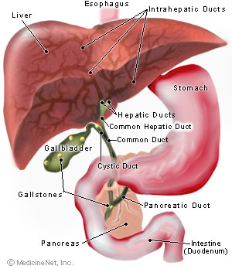
gallbladder
Bile stored in the gallbladder becomes more concentrated, increasing its potency and intensifying its effect. When chyme containing fat leaves the stomach, the gallbladder contracts and discharges bile through the cystic duct and common bile duct and into the duodenum of the small intestine.

Slide 43
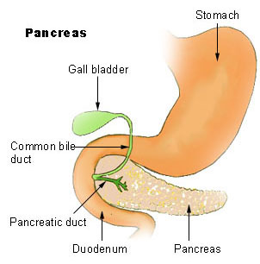
The small intestine: the pancreas
The pancreas secretes pancreatic juice into the duodenum via the pancreatic duct which merges with the common bile duct. This pancreatic juice contains digestive enzymes and bicarbonate ions.
It’s role is so vital to digestion, that a person would starve without it, even if they were consuming an adequate amount of food.

Slide 44
Pancreatic juice
• Pancreatic juice is a transparent, colourless fluid isotonic with plasma.
• About 1200–1500 ml of pancreatic juice is secreted per day.
• Its specific gravity varies from 1.010 to 1.018.
• Pancreatic juice is markedly alkaline (pH 7.8–8.4), due to very high
concentration of HCO3
− (113 mEq/L about 4–5 times that of plasma).
Composition
Pancreatic juice is composed of 99.5% water and 0.5% solids, which
include organic and inorganic substances.
Organic constituents of pancreatic juice are certain enzymes and other substances.
• Enzymes. The pancreas secretes four major types of enzymes: amylase,
lipase, protease and trypsin inhibitor.
• Other organic substances present in traces are albumin and globulin.
Inorganic substances present in the pancreatic juice are cations like Na+, K+, Ca2+, Mg2+ and Zn2+; and anions such as HCO3−, Cl− and traces of SO4 and HPO4. Electrolyte composition varies with rate of secretion (see page 611).

Slide 45
Pancreatic enzymes
Pancreatic acini secrete four major types of enzymes: amylase, lipase,
protease and trypsin inhibitor.
1. Pancreatic ∝ amylase.
It is secreted in its active form. It is the only amylytic enzyme present
with pancreatic juice. Its action on the carbohydrates is like that of
salivary amylase. It hydrolyses glycogen, starch and most other complex
carbohydrates, except cellulose, to form disaccharides.
2. Pancreatic lipases or lipolytic enzymes include pancreatic lipase, cholesterol ester hydrolase and phospholipase A2.
• Pancreatic lipase. It is a powerful lipolytic enzyme. It hydrolyses
neutral fats to glycerol esters and fatty acids. Its activity is accelerated
in the presence of bile salts.
• Cholesterol ester hydrolase converts cholesterol esters to cholesterol.
• Phospholipase A2. It is secreted in an inactive form pro-phospholipase
A2 and gets converted to active form phospholipase A2 by the action of
trypsin. Phospholipase A2 splits fatty acid phoshatidylcholine (PC)
forming Lyso-PC. Lyso-PC damages the cell membrane.

Slide 46
3. Pancreatic proteases
or proteolytic enzymes include three endopeptidases (trypsin,
chymotrypsin and elastase) and two exopeptidases (carboxypeptidase A
and B). Endopeptidases break the peptides somewhere in the middle.
Exopeptidases break the peptide chain near its end, releasing single
amino acid.
• Trypsin. It is the most powerful proteolytic enzyme of the pancreatic
juice. It is secreted in an inactive form of trypsinogen, which is
activated by the enzyme enterokinase (enteropeptidase) secreted by
the duodenal mucosa. Once formed, trypsin also activates trypsinogen
an autocatalytic reaction.
• Trypsin hydrolyses proteins into proteoses and to polypeptides.
• It activates trypsinogen and other pancreatic enzymes.

Slide 47
• Chymotrypsin. It is also secreted in an inactive form chymotrypsinogen
and is activated by trypsin. It hydrolyses the proteins into small
polypeptides.
• Elastase. It is secreted as proelastase, which is activated by trypsin. It
digests elastin.
• Carboxypeptidase A and B. These are secreted as procarboxypeptidase
A and B and are activated by enterokinase and trypsin.
• Carboxypeptidase A cleaves the carboxyl-terminal
amino acid that has aromatic or branched aliphatic side
chains.
• Carboxypeptidase B cleaves the carboxyl-terminal
amino acids that have basic side chains.
• Nucleases (ribonuclease and deoxyribonuclease). They split nucleic
acids of ribose and deoxyribose type into nucleotides.
• Collagenase. It is also activated by trypsin and digests collagen.

Slide 48
4. Trypsin inhibitor.
If even a small amount of trypsin is released into the pancreas, the
resulting chain reaction would produce active enzymes that could digest
the pancreas. It is therefore, not surprising that the pancreas normally
contains a trypsin inhibitor, which is secreted by the same cells and at the
same time as the pancreatic proenzymes. The trypsin inhibitor protects
the pancreas from auto-digestion.
Functions of pancreatic juice
1. Digestive functions.
The pancreatic juice is the major source of digestive enzymes that digest
all components of the food—proteins, carbohydrates, fats and nucleic
acid.
2. Neutralizing function.
Pancreatic juice is highly alkaline due to high concentration of HCO3
and neutralizes the gastric HCl in the chyme that enters the duodenum.

Slide 49
Pancreatic function tests
Pancreatic function tests are performed to evaluate the normal
functioning of the pancreas and to detect abnormality, if any. The
function tests to evaluate the functioning of the exocrine part of the
pancreas can be divided as follows:
• Analysis of pancreatic juice,
• Analysis of products of digestion and
• Estimation of serum amylase levels.

Slide 50
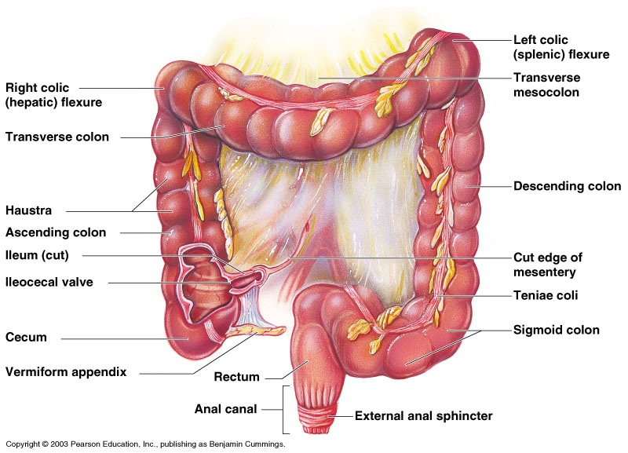
Large Intestine
Figure 14.8
Copyright © 2003 Pearson Education, Inc. publishing as Benjamin Cummings

Slide 51
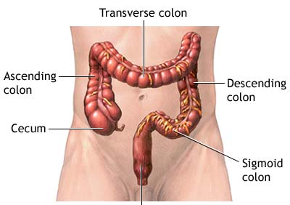
The function of the large intestine, or bowel, is to absorb the remaining water and nutrients from indigestible food matter, store unusable food matter (wastes), and then eliminate the wastes from the body. The large intestine is subdivided into the cecum and the ascending/transverse/ descending/and sigmoid colon sections.
The large intestine is only about 4-5 feet in length, and 2 ½ inches in diameter.

Slide 52
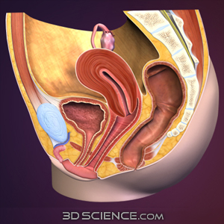
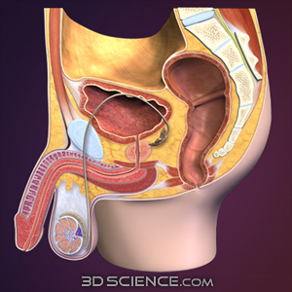
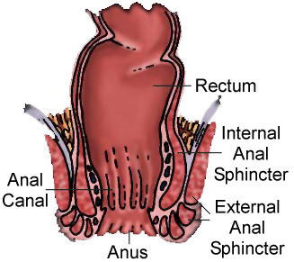
The rectum and anus…
The rectum is where feces are stored until they leave the digestive system, through the anus as a bowel movement.
As the rectal walls expand with waste material, receptors from the nervous system stimulate the desire to defecate. For defecation or egestion, we consciously relax the external anal sphincter muscle to expel the waste through the anus.

Slide 53
Food Breakdown and Absorption in the Large Intestine
No digestive enzymes are produced
Resident bacteria digest remaining nutrients
  Produce some vitamin K and B
  Release gases
Water and vitamins K and B are absorbed
Remaining materials are eliminated via feces
Copyright © 2003 Pearson Education, Inc. publishing as Benjamin Cummings

